Slide 1
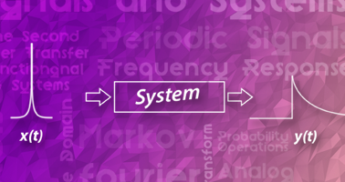
Signals and Systems UE18EC202

Slide 2
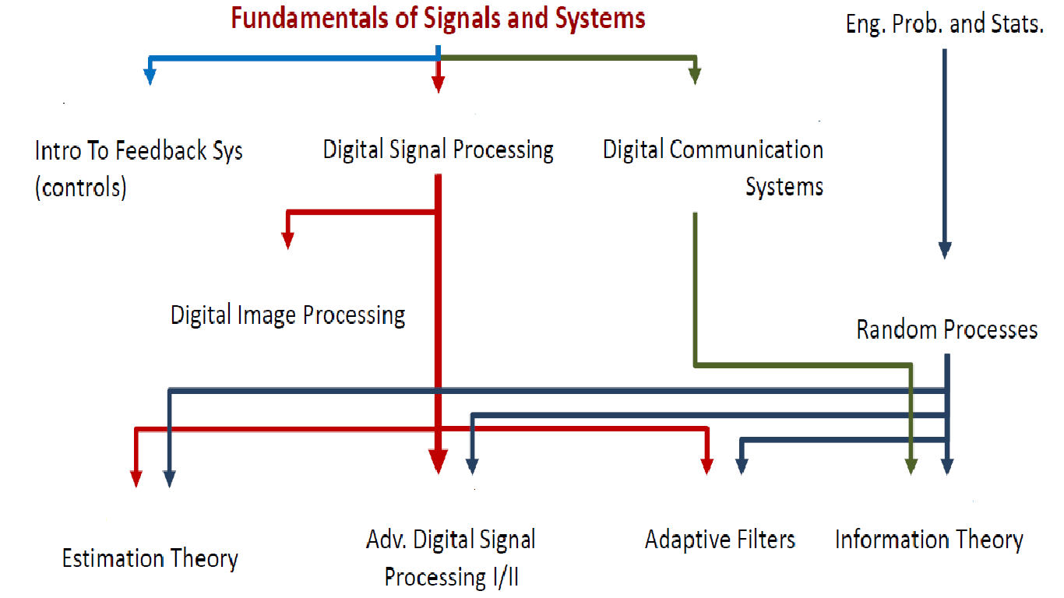
Motivation
Fundamental subject

Slide 3
Why study Signals and Systems?
Engineers build systems that process/manipulate signals.
We need a formal mathematical framework for the study of such systems.
Such a framework is necessary in order to ensure that a system will meet the required specifications (e.g., performance and safety).
If a system fails to meet the required specifications or fails to work altogether, negative consequences usually ensue.
When a system fails to operate as expected, the consequences can sometimes be catastrophic.

Slide 4
OUTCOMES
Classify systems based on their properties: in particular, exploit the implications of linearity, time-invariance, causality, memory, and bounded-input, bounded-out (BIBO) stability.
Determine Fourier transforms for continuous-time and discrete-time signals (or impulse-response functions), interpret and plot Fourier transform magnitude and phase functions..
Use the relationships among the various representations of LTI systems—linear constant-coefficient difference or differential equation, frequency response, transfer function, and impulse response—and infer one representation from another (e.g., determine the impulse response from the difference equation, etc.).

Slide 5
OUTCOMES
Determine the conditions for a time-domain function to have a Fourier transform, and know how to relate the Fourier transform to its Z transform.
Analyze and design signals and system using transformation technique.
Use the unilateral Z transform to decompose the response of an LTI system into a zero-state component and a zero-input component, and solve linear, constant-coefficient difference equations, with possibly non-zero initial conditions.

Slide 6
Syllabus
Unit 1 : 10 hrs
Signals and systems :
Classification of signals
Continuous-time and discrete-time signals
Transformations of the independent variable
Exponential and sinusoidal signals
The unit impulse and unit step functions
Continuous-time and discrete-time systems
Basic system properties.

Slide 7
Syllabus
Unit 2 : 10 hrs
Linear time-invariant systems:
Discrete-time LTI systems: The convolution sum
Continuous-time LTI systems: The convolution integral
Properties of LTI systems
Causal LTI systems described by differential / difference equations (Natural, Forced, and Complete Response)

Slide 8
Syllabus
Unit 3 : 10 hrs
Fourier series representation of periodic signals :
Response of LTI systems to complex exponentials
Trigonometric Fourier Series
Fourier series representation of continuous-time periodic signals
Convergence of the Fourier series
Properties of continuous-time Fourier series
Introduction to Fourier series representation of discrete-time periodic signals.

Slide 9
Syllabus
Unit 4: 12 hrs
The continuous-time Fourier transform:
Representation of aperiodic signals: the continuous-time Fourier transform
The Fourier transform for periodic signals,
Properties of continuous-time Fourier transform, Fourier transform pairs.
The discrete-time Fourier transform:
Representation of aperiodic signals: the discrete-time Fourier transform
The Fourier transform for discrete periodic signals
Properties of discrete-time Fourier transform, Fourier transform pairs
Duality. Frequency Response of LTI Systems Magnitude and Phase response.

Slide 10
Syllabus
Unit 5: 10 hrs
The Z-transform:
The Z-transform
The region of convergence for the Z-transform
The inverse Z-transform
Properties of the Z-transform
Z-transform pairs
Analysis and characterization of LTI systems using Z-transforms.
The unilateral Z-transform and solution of difference equations.

Slide 11
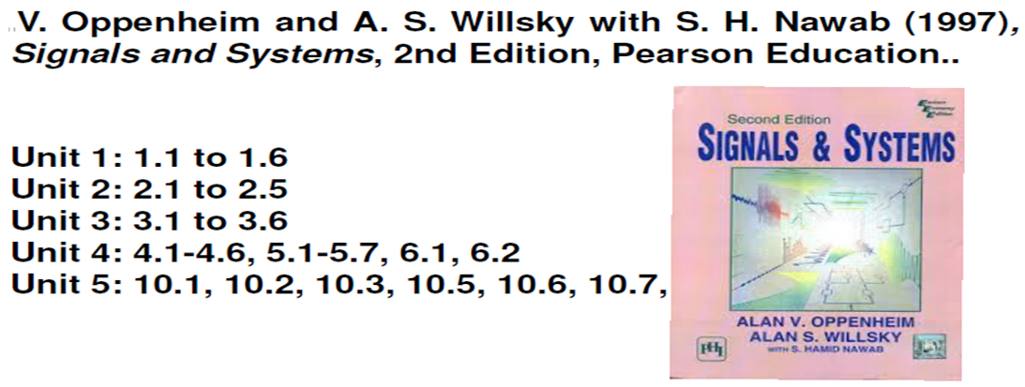
Textbook

Slide 12
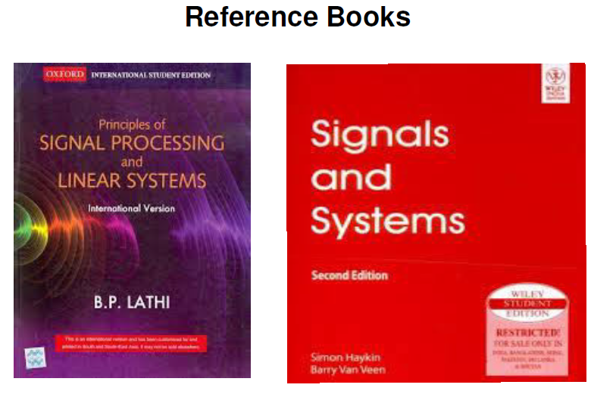

Slide 13
What is a Signal?
Signal (dependent variable) is any real world quantity varying with time, space or frequency (independent variable)
Signals are variables that carry information
Examples of signal include:
Electrical signals
Voltages and currents in a circuit
Mechanical signals
Velocity of a car over time
Audio and Video signals
Intensity level of a pixel (camera, video) over time

Slide 14
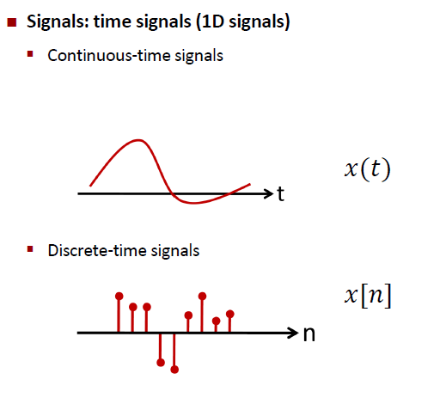

Slide 15
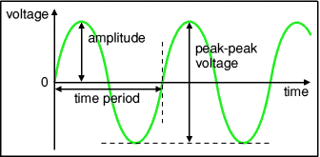


Slide 16
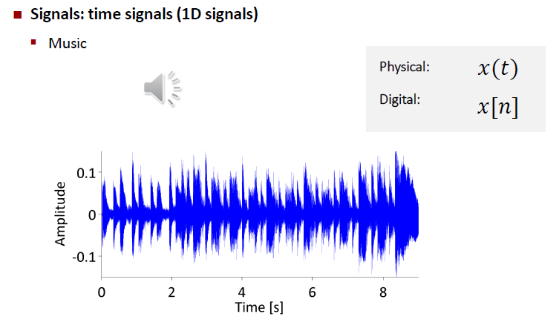

Slide 17
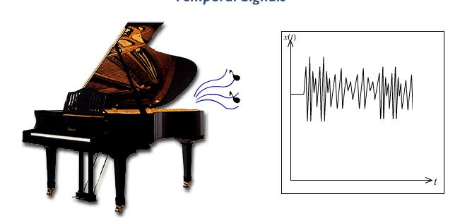
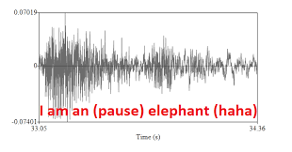
AUDIO SIGNAL
SPEECH SIGNAL

Slide 18
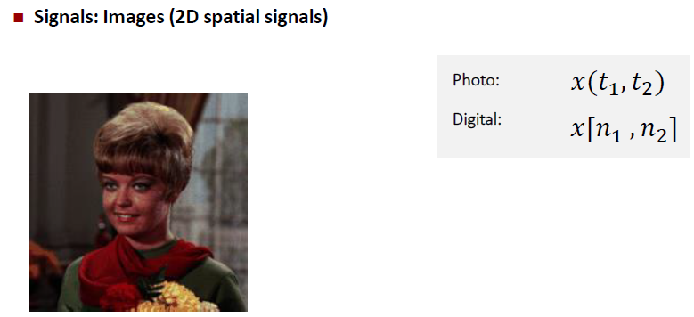

Slide 19
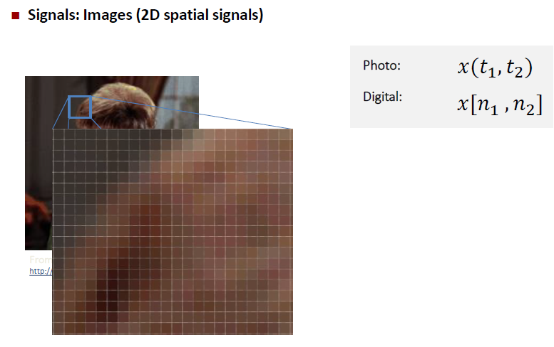

Slide 20
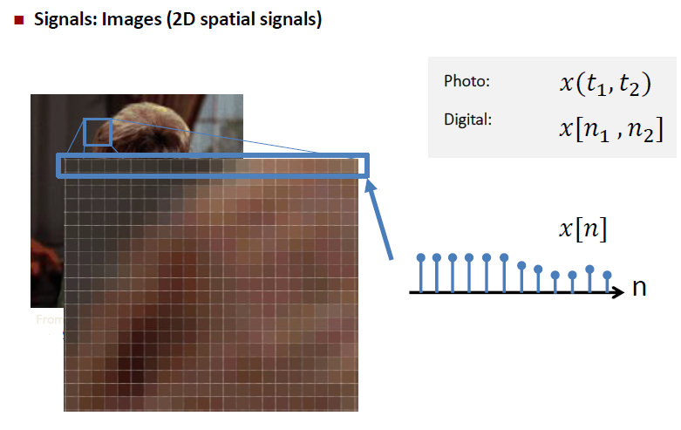

Slide 21
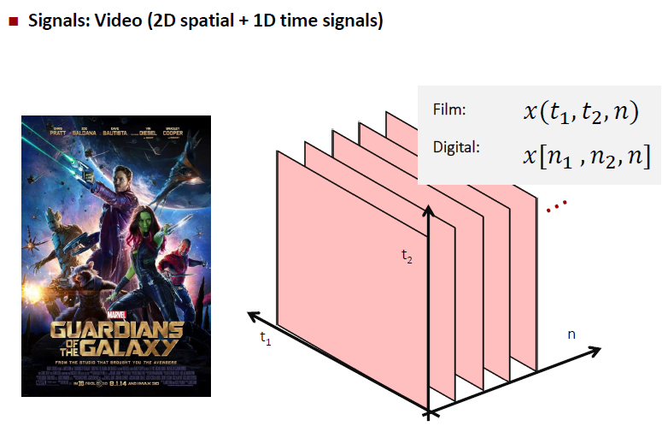

Slide 22
Continuous-Time Signal
Most signals in the real world are continuous time, as the scale is infinitesimally fine.
Eg voltage & current, pressure, temperature, velocity, etc.
Denoted by x(t), where the time interval may be bounded (finite) or infinite
x(t)
t

Slide 23
Discrete time signal
Some real world and many digital signals are discrete time, as they are sampled
E.g. pixels, daily stock price (anything that a digital computer processes)
Denoted by x[n], where n is an integer value that varies discretely
x[n]
n
Many human-made Signals are DT

Slide 24
System
A collection of items that together performs a function
Modifies / transforms an input to give an output
Represented by
x(t)
System
T{ }
y(t) = T{x(t)}
ex. A squaring system
x(t)
T = input²
y(t) = T{x(t)} = x²(t)

Slide 25
Real-World Examples of Systems
Circuits
Car
Inputs → Steering wheel, force on accelerometer and brakes
Outputs → Position of car, velocity
Chemical processes
Electromechanical systems (motors)
Economics, stock market
Biological processes (heart)

Slide 26
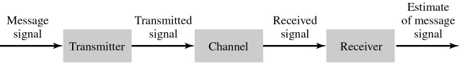
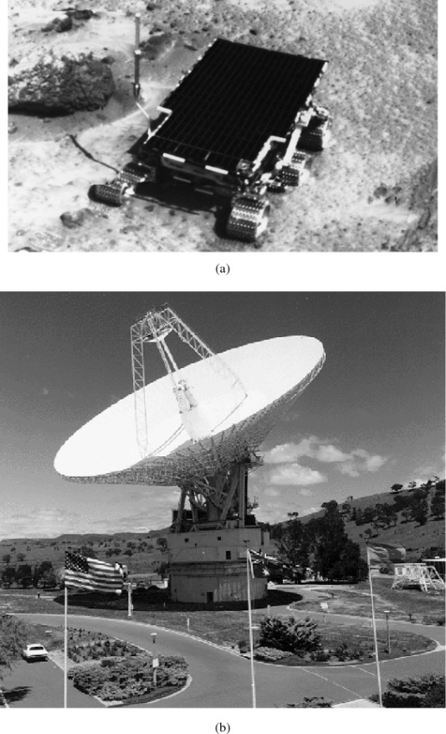
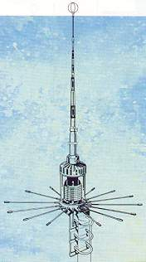

Communication system

Slide 27
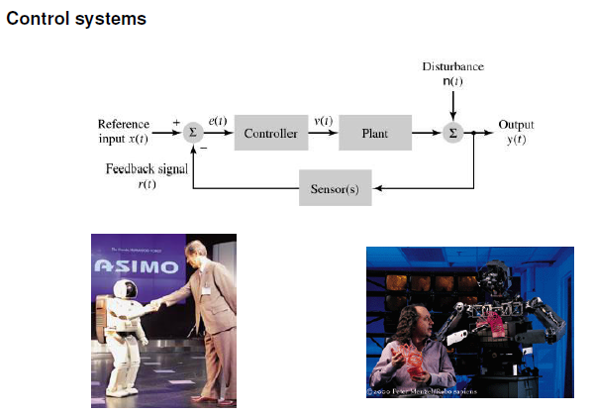

Slide 28
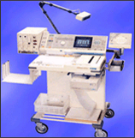
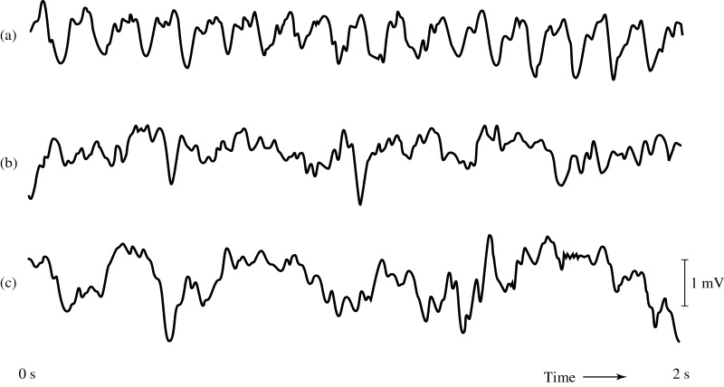
Biomedical system

Slide 29
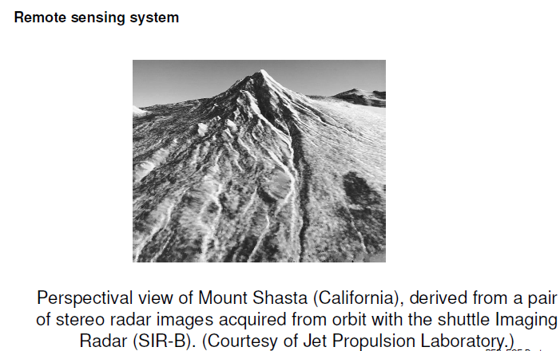

Slide 30
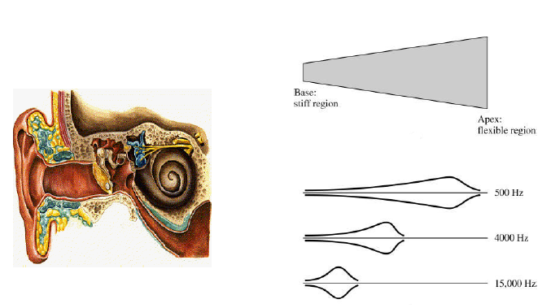
Auditory system

Slide 31
Two types of systems
Continuous-time systems
Operate on continuous-time signals
Represented mathematically using differential equations
System parameters are defined on a continuum of time
Discrete-time systems
Operate on discrete-time signals
Represented mathematically by difference equations
System parameters are defined only at discrete points in time

Slide 32
Classification of Signals
Number of independent variables (i.e., dimensionality):
A signal with one independent variable is said to be
one dimensional (e.g.,audio).
A signal with more than one independent variable is said to be
multi-dimensional (e.g., image).
Continuous or discrete independent variables:
A signal with continuous independent variables is said to be continuous time (CT) (e.g., voltage waveform).
A signal with discrete independent variables is said to be discrete time (DT) (e.g., stock market index).
Continuous or discrete dependent variable:
A signal with a continuous dependent variable is said to be continuous valued (e.g., voltage waveform).
A signal with a discrete dependent variable is said to be discrete valued (e.g., digital image).
A continuous-valued CT signal is said to be ANALOG (e.g., voltage waveform).
A discrete-valued DT signal is said to be DIGITAL (e.g., digital audio).

Slide 33

Size of a Signal !!!
The size of any entity is a number that indicates the largeness or the strength of that entity.
Generally, signal amplitude varies with time.
Is it possible to provide a measure of the varying amplitude by one number ?
That measure must consider not only the signal amplitude, but also duration.
For example, Let V be a measure of the size of a human being.
Width (grith) and
Height
$V= π\int_{o}^{H}{r^{2}\left(h\right)dh}$

Slide 34

With the previous analogy, consider the area under a signal $x\left(t\right)$ as a possible measure of its size. It takes account of
Amplitude

Slide 35

Signal Energy
With the previous analogy, consider the area under a signal $x\left(t\right)$ as a possible measure of its size. It takes account of
Amplitude
Time duration
i.e $\int_{−∞}^{∞}{x\left(t\right)dt}$
But, with the above measure there is a chance that positive and negative cycle can cancel each other and indicating a signal of small size !!!!
This difficulty is surmounted as
$$\int_{−∞}^{∞}{x^{2}\left(t\right)dt}$$
This is called as Signal Energy

Slide 36

Signal Energy
With the previous analogy, consider the area under a signal $x\left(t\right)$ as a possible measure of its size. It takes account of
Amplitude
Time duration
i.e $\int_{−∞}^{∞}{x\left(t\right)dt}$
But, with the above measure there is a chance that positive and negative cycle can cancel each other and indicating a signal of small size !!!!
This difficulty is surmounted as
$\int_{−∞}^{∞}{x^{2}\left(t\right)dt}$ or
$\int_{−∞}^{∞}{{\left|x(t)\right|}^{2}dt}$ for complex valued signal
This is called as Signal Energy
Notes:
It is indicative of the energy that can be extracted from the signal

Slide 37

Signal Power
The signal energy must be finite for it to be meaningful measure of the signal size.
The condition for the energy to be finite is that the signal amplitude should become zero asymptotically.
Otherwise, the integral will not converge.
Therefore, a meaningful measure of the signal size in such case would be the time average of the energy (if it exists).
i.e $\lim_{T→∞}{\frac{1}{T}\int_{−T/2}^{T/2}{x^{2}\left(t\right)dt}}$
This measure is called Signal Power.
$$P_{x}= \lim_{T→∞}{\frac{1}{T}\int_{−T/2}^{T/2}{{\left|x(t)\right|}^{2} dt}}$$
when $x\left(t\right)$ is complex valued signal

Slide 38

Discrete time signals
Signal Energy
$$\sum_{n= −∞}^{∞}{{\left|x[n]\right|}^{2}}$$
Signal Power
$$\lim_{N→∞}{\frac{1}{2N+1}\sum_{n= −N}^{N}{{\left|x[n]\right|}^{2}}}$$

Slide 39
Transformations of the Independent Variable

Slide 40

Time Shift (Translation)
Time shifting (also called translation) maps the input signal x to the output signal y as given by
$$y(t) = x(t −b)$$
$$y\left[n\right]=x[n−b]$$
where b is a real number for CT Signal and b is a Integer for DT Signals.
Such a transformation shifts the signal (to the left or right) along the time axis.
If b > 0, y is shifted to the right by |b|, relative to x (i.e., delayed in time).
If b < 0, y is shifted to the left by |b|, relative to x (i.e., advanced in time).

Slide 42
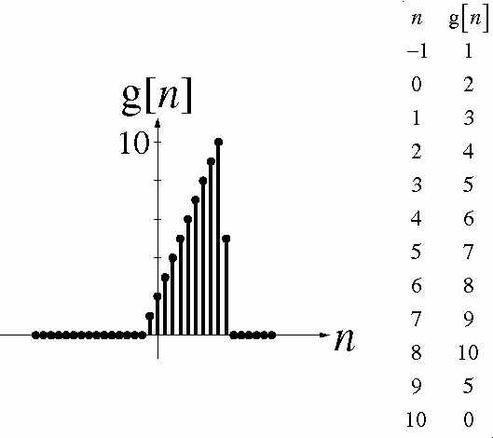
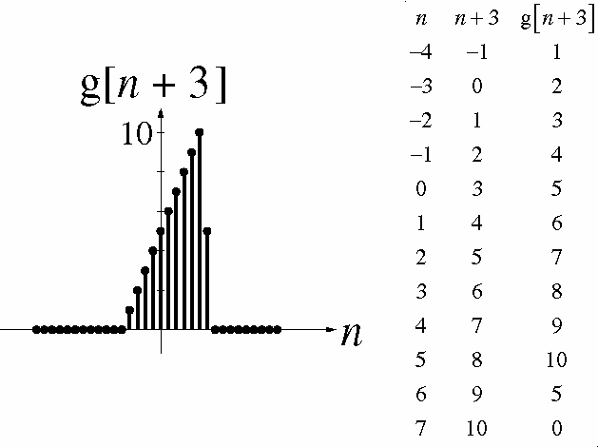

Slide 43

Time Reversal (Reflection)
Time reversal (also known as reflection) maps the input signal x to the output signal y as given by
$$y(t) = x(−t)$$
$$y\left[n\right]=x\left[−n\right]$$
Geometrically, the output signal y is a reflection of the input signal x about the (vertical) line t = 0.

Slide 44
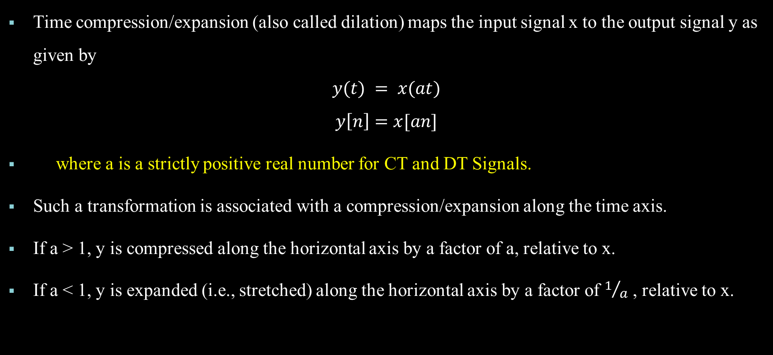
Time Scaling
Time compression/expansion (also called dilation) maps the input signal x to the output signal y as given by
$$y(t) = x(at)$$
$$y\left[n\right]=x[an]$$
where a is a strictly positive real number for CT and DT Signals.
Such a transformation is associated with a compression/expansion along the time axis.
If a > 1, y is compressed along the horizontal axis by a factor of a, relative to x.
If a < 1, y is expanded (i.e., stretched) along the horizontal axis by a factor of $1/a$ , relative to x.

Slide 46
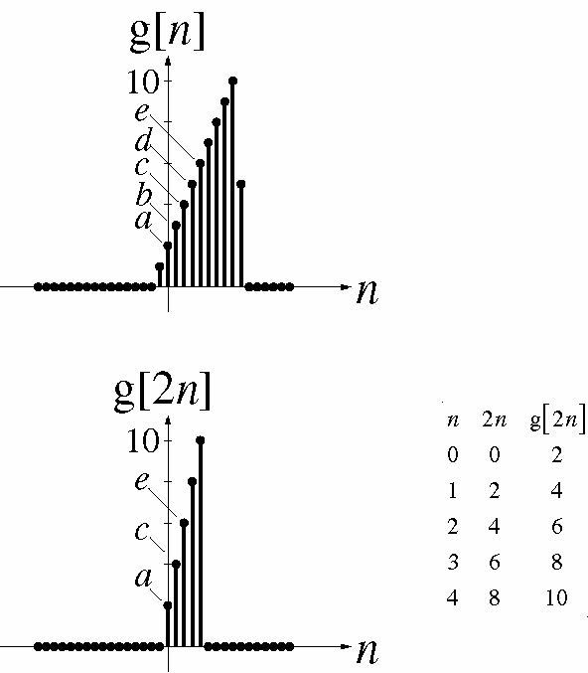
K an integer > 1

Slide 47
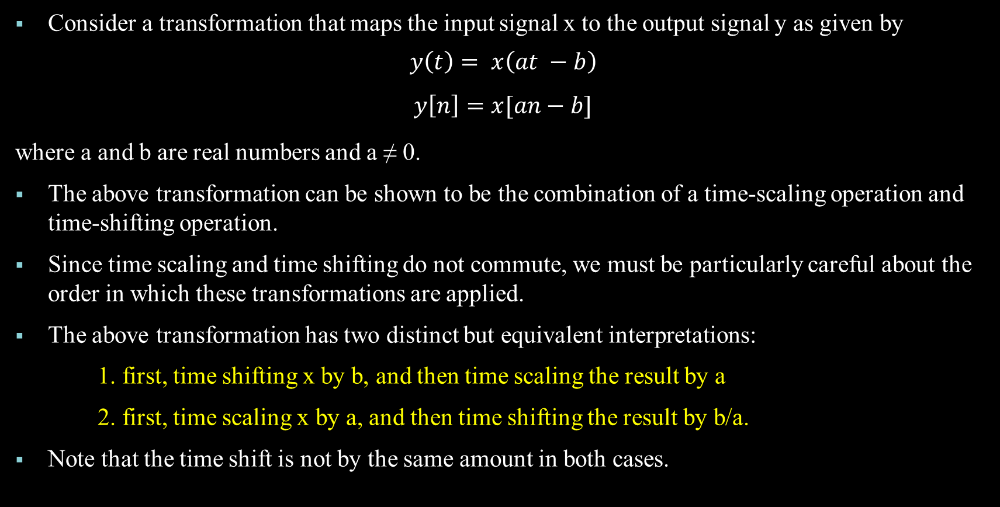
Combined Time Scaling and Time Shifting
Consider a transformation that maps the input signal x to the output signal y as given by
$$y\left(t\right)= x\left(at −b\right)$$
$$y\left[n\right]=x[an−b]$$
where a and b are real numbers and a ≠ 0.
The above transformation can be shown to be the combination of a time-scaling operation and time-shifting operation.
Since time scaling and time shifting do not commute, we must be particularly careful about the order in which these transformations are applied.
The above transformation has two distinct but equivalent interpretations:
1. first, time shifting x by b, and then time scaling the result by a
2. first, time scaling x by a, and then time shifting the result by b/a.
Note that the time shift is not by the same amount in both cases.

Slide 49
Signal Classification
Analog and Digital Signals
Deterministic and Random Signals
Even and Odd Signals
Periodic and Aperiodic Signals
Energy and Power Signals
Multi-dimensional and Multi Channel Signals

Slide 50
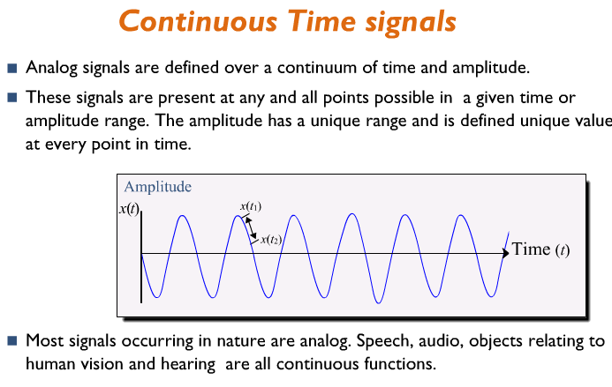

Slide 51
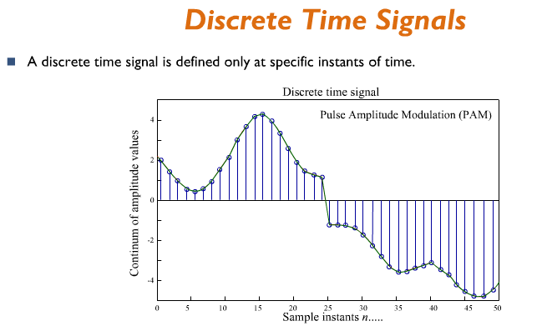

Slide 52
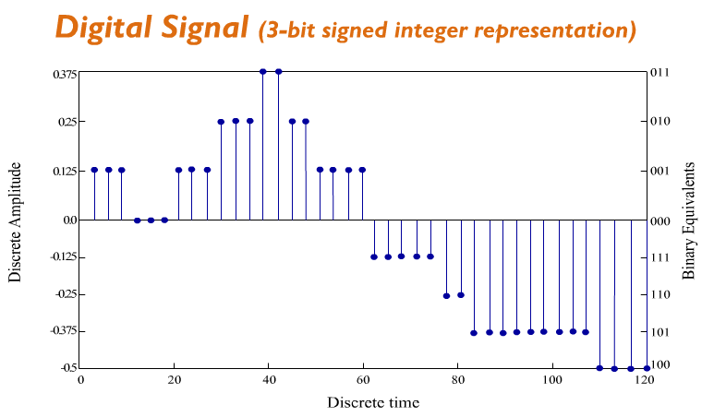

Slide 53

Deterministic Signals
Deterministic signal is a signal exhibiting no uncertainty of value at any given instant of time. Its instantaneous value can be accurately predicted by mathematical equation.
Ex: $A sin⁡wt$

Slide 54
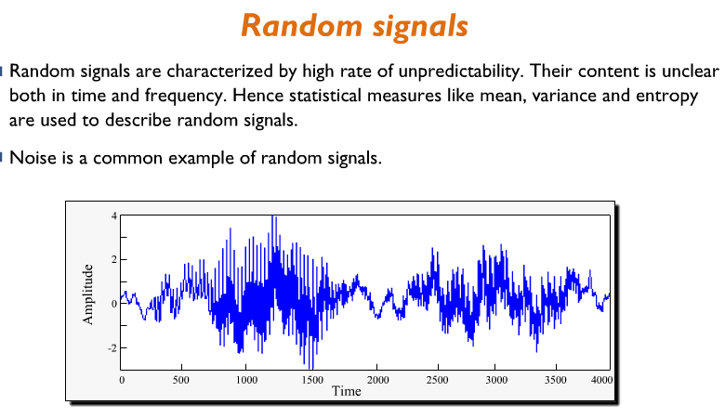

Slide 55
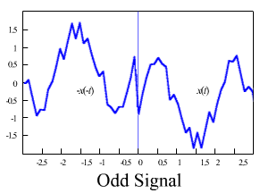
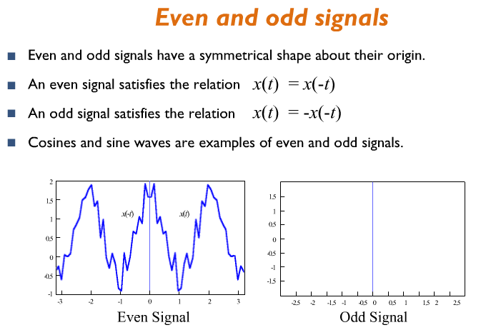

Slide 56
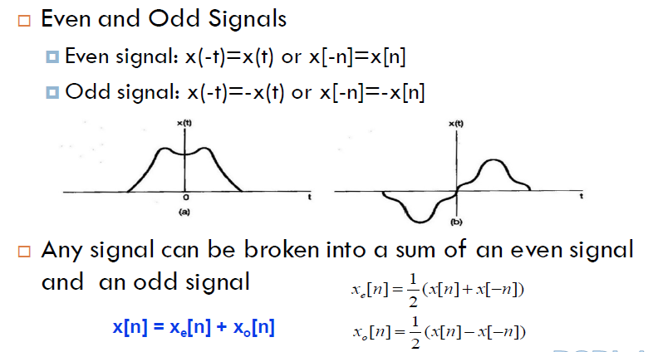
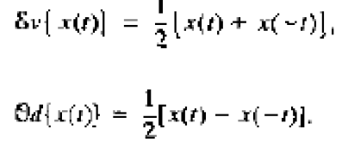

Slide 57
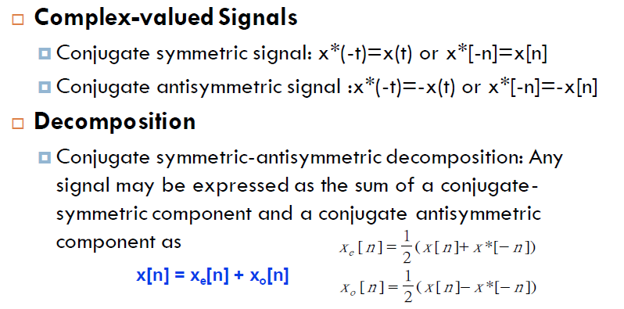

Slide 58
Even and Odd function: Sum and Product
Sums involving even and odd functions have the following properties:
The sum of two even functions is even.
The sum of two odd functions is odd.
The sum of an even function and odd function is neither even nor odd, provided that neither of the functions is identically zero.
That is, the sum of functions with the same type of symmetry also has the same type of symmetry.
Products involving even and odd functions have the following properties:
The product of two even functions is even.
The product of two odd functions is even.
The product of an even function and an odd function is odd.
That is, the product of functions with the same type of symmetry is even, while the product of functions with opposite types of symmetry is odd.

Slide 59
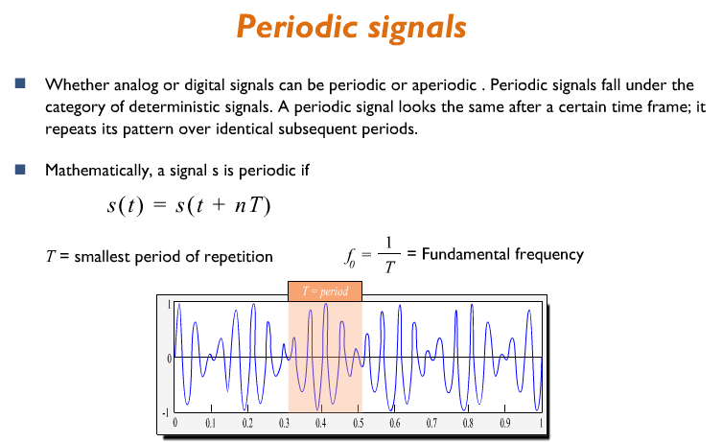

Slide 60
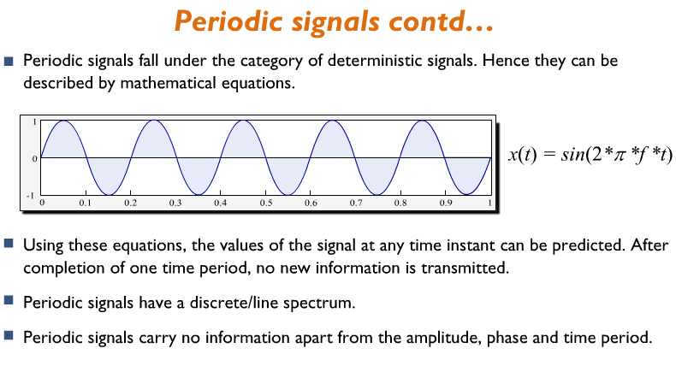

Slide 61
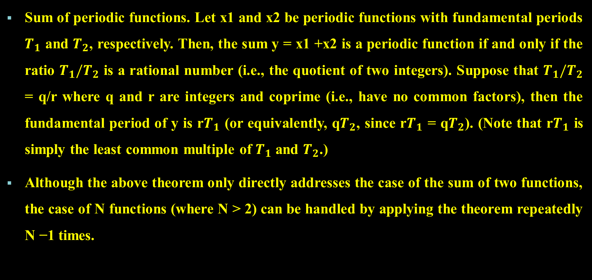
Sum of periodic functions. Let x1 and x2 be periodic functions with fundamental periods $T_{1}$ and $T_{2}$, respectively. Then, the sum y = x1 +x2 is a periodic function if and only if the ratio $T_{1}/T_{2}$ is a rational number (i.e., the quotient of two integers). Suppose that $T_{1}/T_{2}$ = q/r where q and r are integers and coprime (i.e., have no common factors), then the fundamental period of y is r$T_{1}$ (or equivalently, q$T_{2}$, since r$T_{1}$ = q$T_{2}$). (Note that r$T_{1}$ is simply the least common multiple of $T_{1}$ and $T_{2}$.)
Although the above theorem only directly addresses the case of the sum of two functions, the case of N functions (where N > 2) can be handled by applying the theorem repeatedly N −1 times.

Slide 62
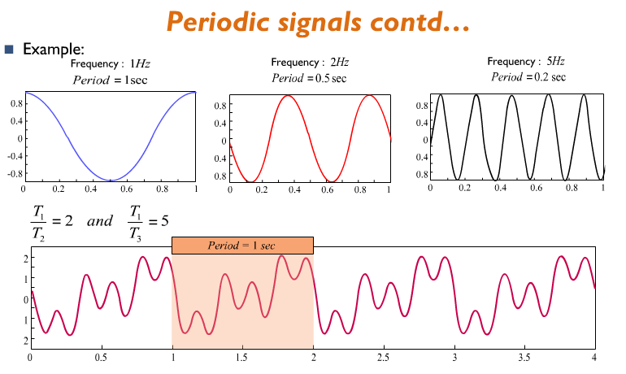

Slide 63
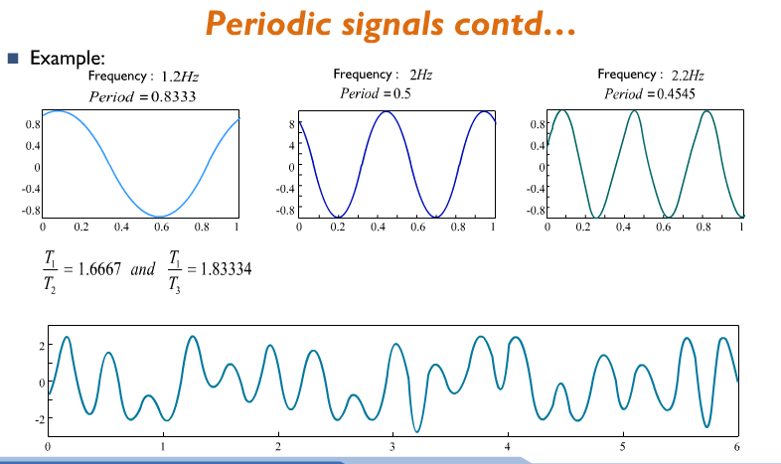

Slide 64
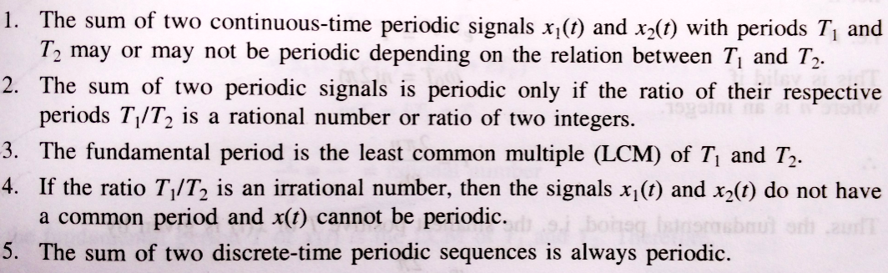

Slide 65
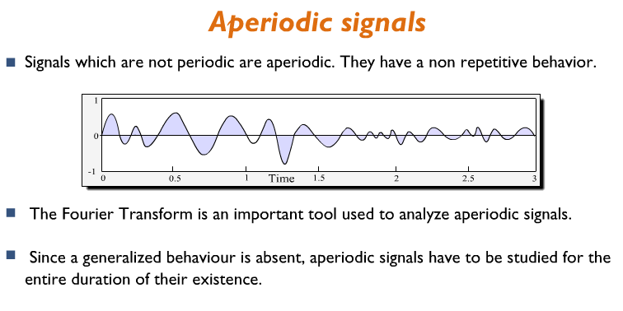

Slide 66
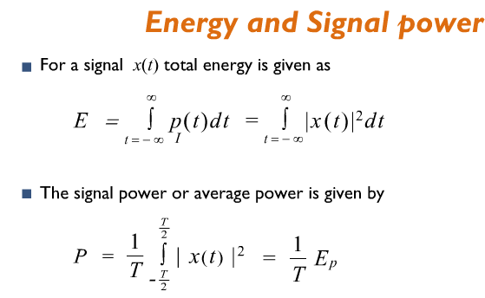
The energy of this signal is the shaded region

Slide 67
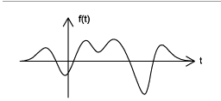
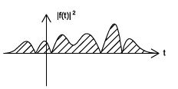
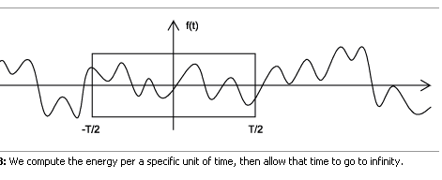
The energy of this signal is the shaded region

Slide 68
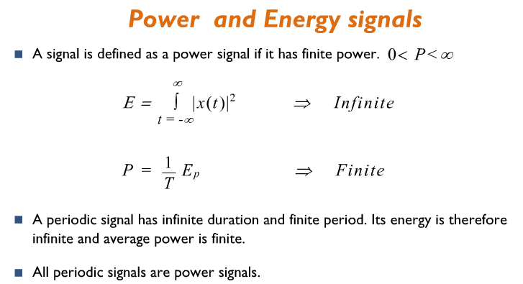

Slide 69
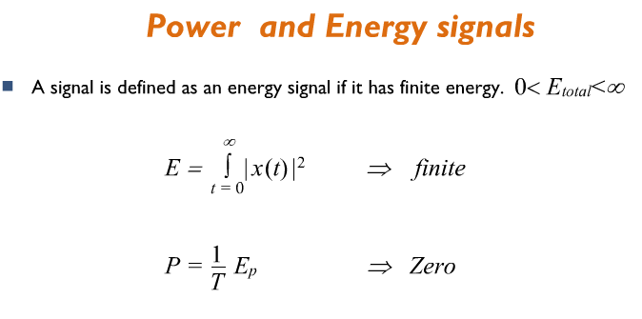
Deterministic Aperiodic signals are Energy Signals

Slide 70
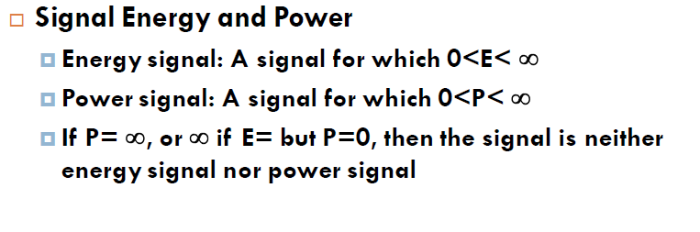

Slide 71
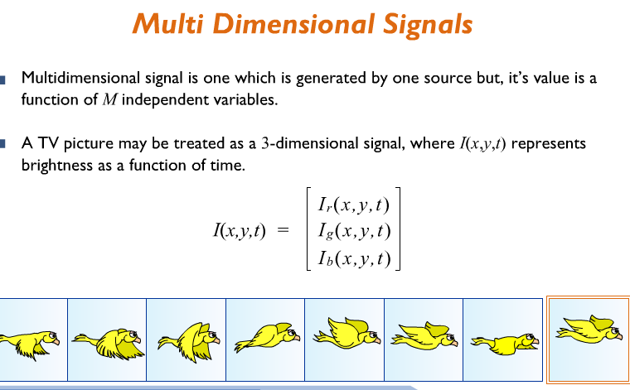

Slide 72


Slide 73



Causal and Anticausal Signals
Causal signals : zero for all negative time
Anticausal signals : zero for all positive time
Noncausal : non-zero values in both positive and negative time
causal signal
anticausal signal
noncausal signal

Slide 74








Elementary signals

Slide 75
Elementary signals
Impulse
Step
Ramp
Sinusoidal
Real exponential
Complex exponential
Signum
Sinc
Triangle
Rectangle
Parabolic

Slide 76


The Discrete-Time Unit Impulse Function
(Dirac or Delta function)
-4 -3 -2 -1 0 1 2 3 4

Slide 77


The Discrete-Time Unit Step Function
-4 -3 -2 -1 1 2 3 4

Slide 78

Relation between Step function and Delta function
The discrete time impulse is the first difference of the discrete time step
$$δ\left[n\right]=u\left[n\right]−u[n−1]$$
The discrete time unit step is the running sum of the unit impulse
$$u\left[n\right]= \sum_{m=−∞}^{n}{δ\left[m\right]}$$
It can be seen that for $n<0, the running sum is zero and for$ $n ≥0$, the running sum is 1.
If we change the variable of summation from $k=n−m$ we have
$$u\left[n\right]= \sum_{k =0}^{∞}{δ\left[n −k\right]}$$

Slide 79


Slide 80

There is a close relation between $δ\left[n\right]$, $u[n]$ and $r\left[n\right]$
$δ\left[n\right]=u\left[n\right]−u[n−1]$ $u\left[n\right]= \sum_{m=−∞}^{n}{δ\left[m\right]}$
$u\left[n\right]=r\left[n+1\right]−r[n]$ r$\left[n\right]= \sum_{m=−∞}^{n−1}{u\left[m\right]}$

Slide 81


Slide 82

Unit Step
The unit-step function (also known as the Heaviside function), denoted $u(t)$, is defined as
$$u\left(t\right)=\left\{\begin{matrix}1 t≥0 \\ 0 otherwise\end{matrix}\right.$$
Due to the manner in which $u$ is used in practice, the actual value of $u(0)$is unimportant. Sometimes values of $0$ and $1/2$ are also used for $u(0)$.
A plot of this function is shown below.

Slide 83



Slide 84




Slide 85


Slide 86



Slide 87



Slide 88


Slide 89
Exponential and Sinusoidal Signals

Slide 90

Real Sinusoids
A (CT) real sinusoid is a function of the form
$x(t) = Acos(ωt +θ$),
where $A,ω,$and $θ$ are real constants.
Such a function is periodic with fundamental period $T =\frac{2π}{\left|ω\right|}$ and fundamental frequency $\left|ω\right|$.
A real sinusoid has a plot resembling that shown below.

Slide 91

Complex Exponentials
A (CT) complex exponential is a function of the form
$x(t) = Ae^{αt}$,
where $A$ and$α$ are complex constants.
A complex exponential can exhibit one of a number of distinct modes of behavior, depending on the values of its parameters $A$ and$α$.
For example, as special cases, complex exponentials include real exponentials and complex sinusoids.

Slide 92

Real Exponential
A (CT) real exponential is a function of the form
$x(t) = Ae^{αt}$,
where $A$ and$α$ are real constants.
A real exponential can exhibit one of three distinct modes of behavior, depending on the value of $α$.
If $α$ > 0, x(t) increases exponentially as t increases (i.e., a growing exponential).
If $α$ < 0, x(t) decreases exponentially as t increases (i.e., a decaying exponential).
If $α$ = 0, x(t) simply equals the constant A
Notes:
e as “a constant approximately 2.71828…” is like calling pi “an irrational number, approximately equal to 3.1415…”

Slide 93


Slide 94


Slide 95


Slide 96

Complex Sinusoid
A complex sinusoid is a special case of a complex exponential
$$x(t) = Ae^{αt}$$
where A is complex and $α$ is purely imaginary (i.e., Re{$α$} = 0).
That is, a (CT) complex sinusoid is a function of the form
$x(t) = Ae^{jωt}$,
where A is complex and 𝜔 is real.
By expressing A in polar form as $A = |A|e^{jθ}$ (where $θ$ is real) and using Euler’s relation, we can rewrite x(t) as
$$x(t) = |A|cos⁡(ωt+θ) +j |A|sin⁡(ωt+θ)$$
$Re\{x\left(t\right) \} Im\{x\left(t\right)\}$
Thus, $Re\{x\}$ and $Im\{x\}$ are the same except for a time shift.
Also, x is periodic with fundamental period $T =\frac{2π}{\left|ω\right|}$ and fundamental frequency $\left|ω\right|$.

Slide 98

General Complex Exponential
In the most general case of a complex exponential $x(t) = Ae^{αt}$, $A$ and $α$ are both complex.
Letting $A = |A|e^{jθ}$ and $α = σ+jω$(where $θ$, $σ$ and $ω$are real), and using Euler’s relation, we can rewrite $x(t)$ as
$$x(t) = |A|e^{σt}cos⁡(ωt+θ) +j |A|e^{σt}sin⁡(ωt+θ)$$
$Re\{x\left(t\right) \} Im\{x\left(t\right)\}$
Thus, $Re\{x\}$ and $Im\{x\}$ are each the product of a real exponential and real sinusoid.
One of three distinct modes of behavior is exhibited by $x(t)$, depending on the value of$σ$.
If $σ = 0$, $Re\{x\}$ and $Im\{x\}$ are real sinusoids.
If $σ > 0$, $Re\{x\}$ and $Im\{x\}$ are each the product of a real sinusoid and a growing real exponential.
If $σ < 0$, $Re\{x\}$ and $Im\{x\}$ are each the product of a real sinusoid and a decaying real exponential.

Slide 100

Relationship Between Complex Exponentials and Real Sinusoids
From Euler’s relation, a complex sinusoid can be expressed as the sum of two real sinusoids as
$$Ae^{jωt}= Acosωt+ jAsinωt$$
Moreover, a real sinusoid can be expressed as the sum of two complex sinusoids using the identities
$$Acos⁡(ωt+θ) = \frac{A}{2}[e^{j\left(ωt+θ\right)}+e^{−j\left(ωt+θ\right)}]$$
$$Asin\left(ωt+θ\right)= \frac{A}{2j}[e^{j\left(ωt+θ\right)}− e^{−j\left(ωt+θ\right)}]$$

Slide 101
Discrete-Time Complex Exponentials and Sinusoidal Signals

Slide 102

DT Real Sinusoids
A (DT) real sinusoid is a sequence of the form
$$x(n) = Acos(Ωn+θ),$$
where $A, Ω$ and 𝛉 are real constants.
A real sinusoid is periodic if and only if $\frac{Ω}{2π}$is a rational number, in which case the fundamental period is the smallest integer of the form $\frac{2πk}{|Ω|}$ where k is a positive integer.
For all integer k, $x_{k}(n) = Acos( [Ω+2πk]n+θ)$ is the same sequence.
An example of a periodic real sinusoid with fundamental period 12 is shown plotted below.

Slide 103


Slide 104


Slide 105

Notes:
${\text{Ω}}_{0}$ $n_{0} =\frac{π}{2}$ $\frac{π}{8}n_{0}$ = $\frac{π}{2} { n}_{0}$ = 4

Slide 106


Slide 107


Slide 108


Slide 109


Slide 110


Slide 111

Complex Exponentials
A (DT) complex exponential is a sequence of the form
$x(t) =Ca^{n}$,
where $C$ and$a$ are complex constants.
A complex exponential can exhibit one of a number of distinct modes of behavior, depending on the values of the parameters c and a.
For example, as special cases, complex exponentials include real exponentials and complex sinusoids.

Slide 112

Real Exponentials
A (DT) real exponential is a special case of a complex exponential
$$x\left(t\right)=Ca^{n}$$
where c and a are restricted to be real numbers.
A real exponential can exhibit one of several distinct modes of behavior, depending on the magnitude and sign of a.
If |a| > 1, the magnitude of x[n] increases exponentially as n increases (i.e., a growing exponential).
If |a| < 1, the magnitude of x[n] decreases exponentially as n increases (i.e., a decaying exponential).
If |a| = 1, the magnitude of x[n] is a constant, independent of n.
If a > 0, x[n] has the same sign for all n.
If a < 0, x[n] alternates in sign as n increases/decreases.

Slide 115


Slide 116


Slide 117


Slide 118


Slide 119
Complex Sinusoids

Slide 121
General Complex Exponential

Slide 123



Slide 124


Slide 125


Slide 126



Slide 127


Unit step
Ramp signal

Slide 128
SYSTEMS AND CLASSIFICATION OF SYSTEMS (BASED ON PROPERTIES)

Slide 129

Systems

Slide 130
Continuous Time and Discrete Time Systems

Slide 131
Notes:
Often, a system defined by the operator H and having the input x and
output y is represented in the form of a block diagram as shown below.

Slide 132


Slide 133


Slide 134

Series (Cascade) and Parallel
Interconnecting Systems

Slide 135

Feedback Systems

Slide 136


Slide 137


Slide 138
Classification of Systems (based on Properties)
Static and Dynamic Systems
Invertible and Non-invertible systems
Time-Variant and Time-Invariant systems
Linear and Non-linear systems
Causal and Non-causal systems
Memory and Memoryless Systems
Stable and Unstable systems

Slide 139
Static and Dynamic Systems
When the output of the system depends only upon the present input sample, then system is called static system
Hence such Systems do no need memory for its operation
Input/output relation of such systems does not involve integrals or derivatives for CT systems and delay or shifts for DT systems.
Example:
y(t) = 5x(t)
y[n] = 15x²[n] + 10x[n]

Slide 140

When the output of the system depends upon the present input sample and previous input and output, then system is called Dynamic system
Hence system need memory to store the previous input / output.
Equation Characterizing a dynamic system will always be a differential equation or difference equation.
Example:
$$y \left[n\right]+ y\left[n−1\right]= x \left[n\right]+ x\left[n−1\right]+ x \left[n−2\right]+ x \left[n−3\right]+ x [n−4]$$
$$\frac{dy(t)}{dt}+y\left(t\right)=x\left(t\right)+\frac{dx(t)}{dt}$$

Slide 141


Slide 142


Slide 143


Slide 144


Slide 145


Slide 146


Slide 147

Time-Invariant and Time-Variant Systems (Shift- Invariant and Shift-Variant Systems)
The input - output characteristics of the system do not change with shift of time origin, such systems are called shift-invariant or time-invariant systems
Example:
$$x (t) −−−T−−− y (t)$$
Then system is said to be time-invariant if
$x (t−τ) −−−T−−− y (t−τ)$
It is very difficult to implement shift variant systems

Slide 148


Slide 149


Slide 150


Determine whether the following system are shift invariant or not
$y \left[n\right]= x [n] – x[n−1]$
$Y \left[n\right]= n x [n$]
$Y \left[n\right]= x [−n]$
$Y \left[n\right]= x [n] cos⁡w0n$
$$1. Y \left[n\right]= T \left[x \left[n\right]\right]= x [n] – x[n−1]$$
Let the input be $x [n – k]$then
i.e. Replace n inside $x[n$] by $[n−k]$
$T \left[ x \left[n – k\right]\right]= x \left[ n − k \right]– x [ n – k – 1]$--------(1)
Let us delay output y [n] by k samples
$y \left[n \right]= x \left[n\right]– x \left[n −1\right] replace n by [ n − k]$
$y \left[n − k\right]= x \left[n − k\right]– x \left[n−k−1\right]$----------------(2)
Hence the system is shift invariant / time invariant

Slide 151

$$2. Y \left[n\right]= n x [n]$$
Note: $T \left[x \left[n\right]\right]= n x [n$]
Let the input be $x [n – k]$then i.e. Replace n inside $x[n$] by $n−k$
$T \left[ x \left[n – k\right]\right]= n x [n – k]$---------------(1)
Let us delay output y [n] by k samples
$y \left[n \right]= n x [n]$ replace $n → n − k$
$y \left[n − k\right]=\left[n − k\right]x [n − k]$----------------(2)
Hence the system is shift variant / time variant

Slide 152

3. $Y \left[n\right]= x [−n]$
Note: $T \left[x \left[n\right]\right]= x [−n]$
So, $T\left[ x \left[n−1\right]\right]= x [−n −1]$
Let the input be x [n – k] then i.e. Replace n inside x[n] by (n – k)
$T \left[ x \left[n – k\right]\right]= x [−n – k]$---------------(1)
Let us delay output y [n] by k samples
$y \left[n\right]= x [−n]$replace $n by (n − k)$
$y \left[n − k\right]= x \left[ −\left[n − k\right]\right]= x [−n + k]$-------------(2)
Hence the system is shift variant / time variant

Slide 153

$$4. Y \left[n\right]= x [n] cos⁡w0n$$
Note: $T \left[x \left[n\right]\right]= x [n] cos⁡w0n$
So, $T\left[ x \left(n−1\right)\right]= x\left(n−1\right)\cos{w_{0}n}$
Let the input be $x (n – k)$then i.e. Replace n inside x[n] by n-k
Let the input be x (n – k) then
$T \left[ x \left[n – k\right]\right]= x [n – k] cos⁡w0n$---------------(1)
Let us delay output y [n] by k samples
$y \left[n\right]= x [n] cos⁡w0n$replace$n by (n − k)$
$y \left[n − k\right]= x [n − k] cos⁡w0(n − k)$-------------(2)
Hence the system is shift variant/ time variant

Slide 154


Slide 155


Slide 156


Slide 157


Slide 158

Linear and Nonlinear Systems

Slide 159

Linear or non linear?

Slide 160

Linear or Non linear systems ?

Slide 161


Slide 162


Slide 163


Slide 164


Slide 165


Slide 166


Slide 167


Slide 168


Slide 169


Slide 170


Slide 171


Slide 172


Slide 173


Slide 174


Slide 175

Casual and Non-Causal Systems
In Causal system the output depends upon only on past and present inputs but not on future inputs.
Example: $y[n] = x[n] + x[n−2]$
In Non-causal system the output depends upon future inputs also..
Example: $y[n] = x[n] + x[n+2$]
In real time, Non-causal systems are physically unrealizable. They are found in Image Processing, when the independent variable is not time !

Slide 176

Determine whether the following System Are Causal Or Non-causal
$$y \left[n\right]= x [n] – x[n−1]$$
Ans : Causal
$$y \left[n\right]= x [n] + x[n+1]$$
Ans : Non-causal
$$y \left[n\right]= x [2n]$$
Ans: Non-Causal

Slide 177


Slide 178


Slide 179


Slide 180


Slide 181

Stable and Unstable Systems
When every ‘bounded’ input produces a ‘bounded’ output, then the system is called Bounded-Input Bounded-Output (BIBO) Stable.
$|x (t/n)|<= M x$(finite number)$< ∞$
Then
$|y (t/n)|<= M_{y}$(finite number)$< ∞$
If bounded input produces unbounded output then the system is unstable. The unstable system produces erratic (unpredictable behavior) output

Slide 182



Slide 183


Slide 184


Slide 185


Slide 186


Slide 187


Slide 188


Slide 189


